Slide 1

SuperPhy A Pilot Resource for Integrated Phylogenetic and Epidemiological Analysis of Pathogens
Matthew D. Whiteside, Chad R. Laing, Akiff Manji, and Victor P.J. Gannon* LABORATORY FOR FOODBORNE ZOONOSES, PUBLIC HEALTH AGENCY OF CANADA

Slide 2
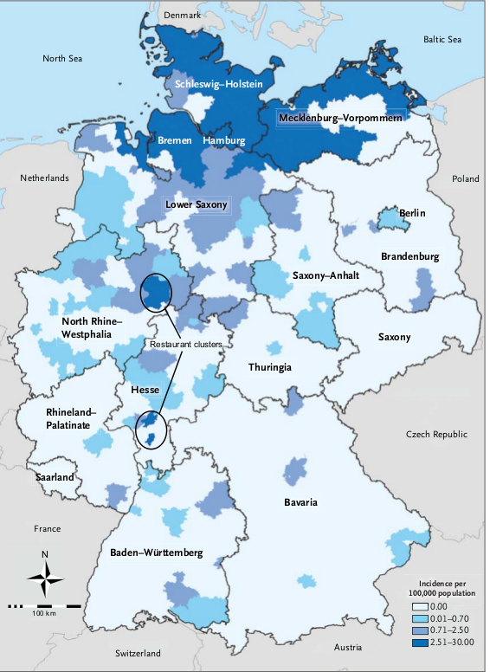
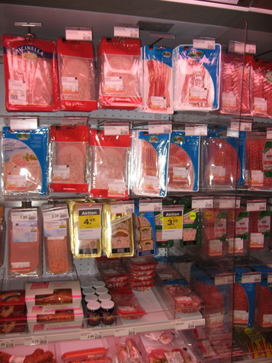
Frank et al., 2011
Escherichia coli O104:H4, Germany 2011
Listeria monocytogenes, Canada, 2008

Slide 3
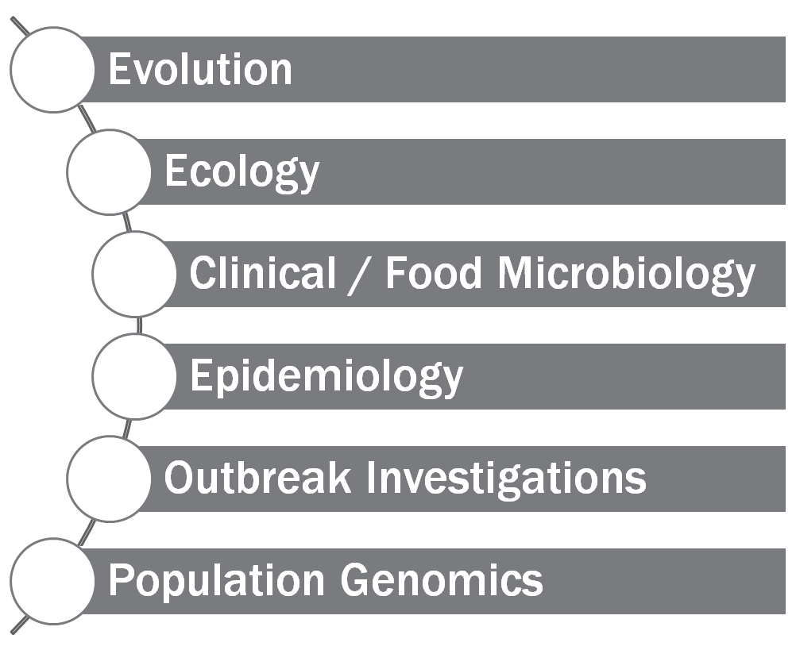

Slide 4
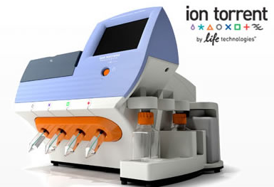
Centralized
Large scale studies
Thousands of genomes
Turn-around time of weeks
Distributed
Point of care / investigation
Tens of genomes
Turn-around time of hours to days

Slide 5
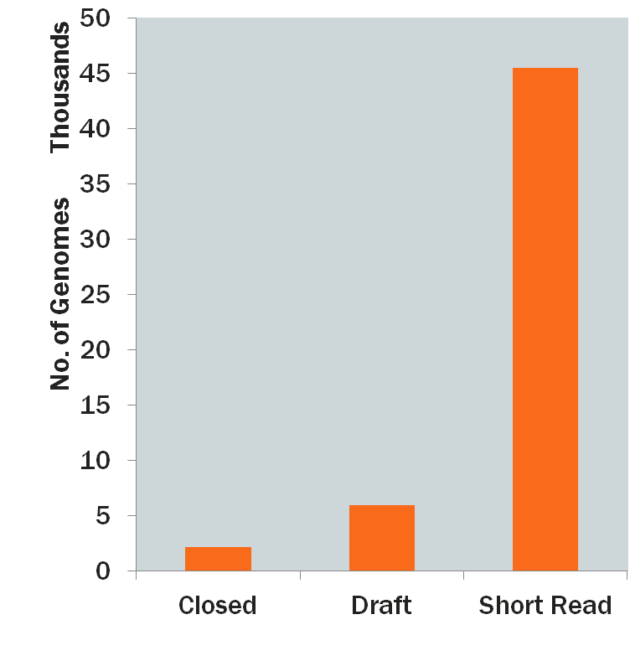
How do we compare thousands of genome sequences in a meaningful and timely manner?

Slide 6
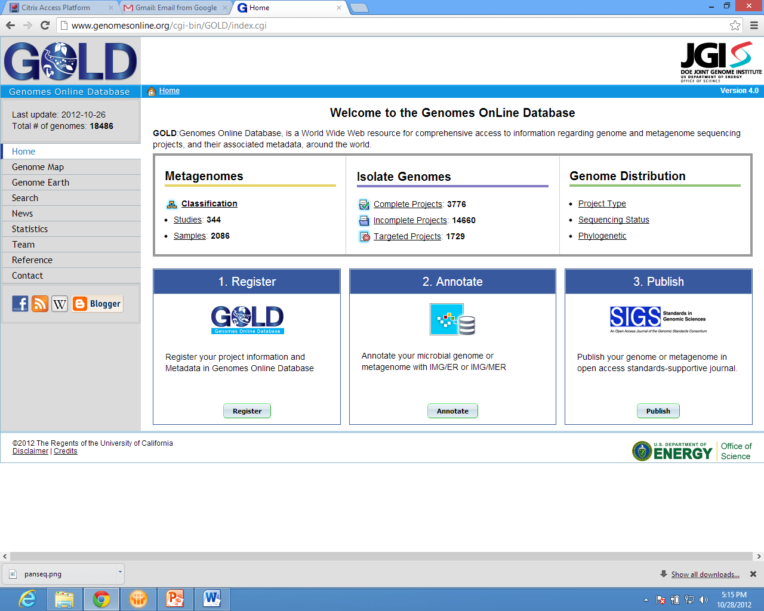
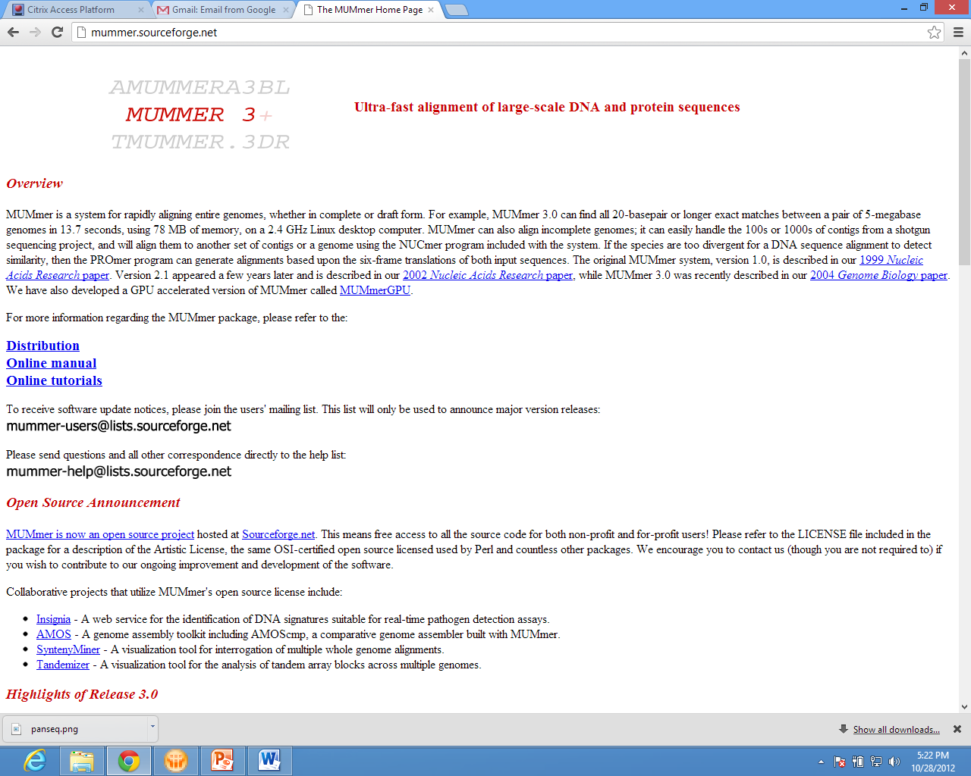
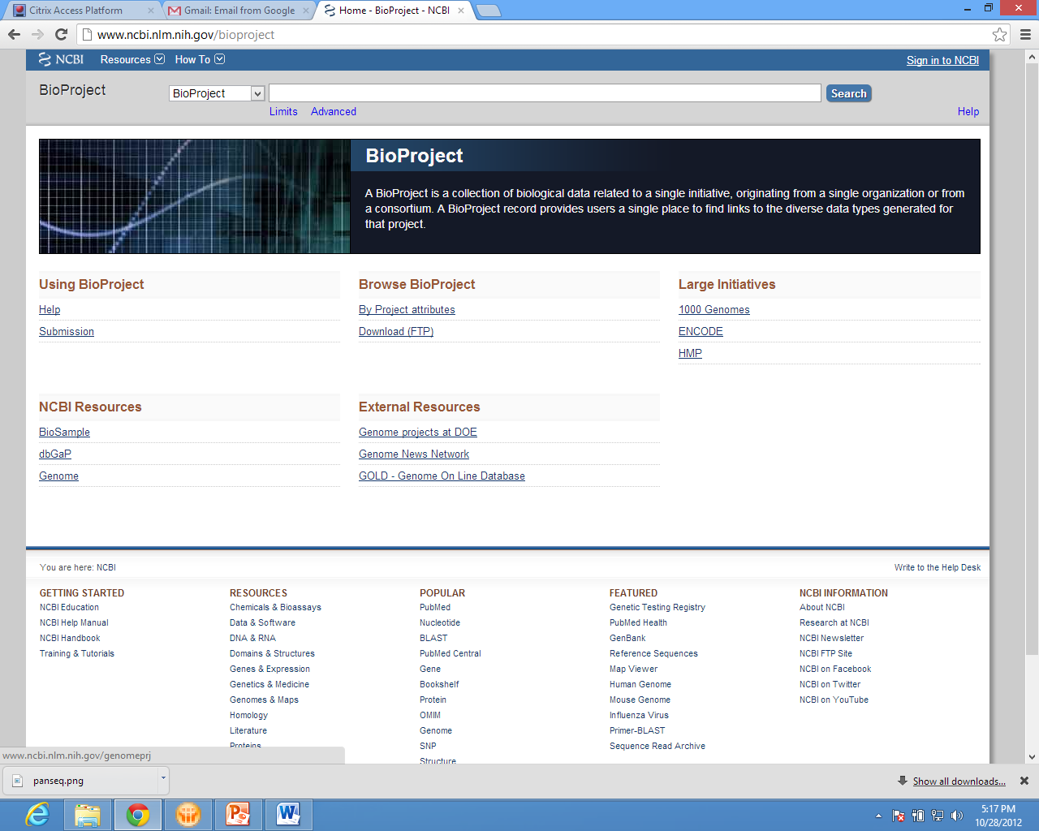
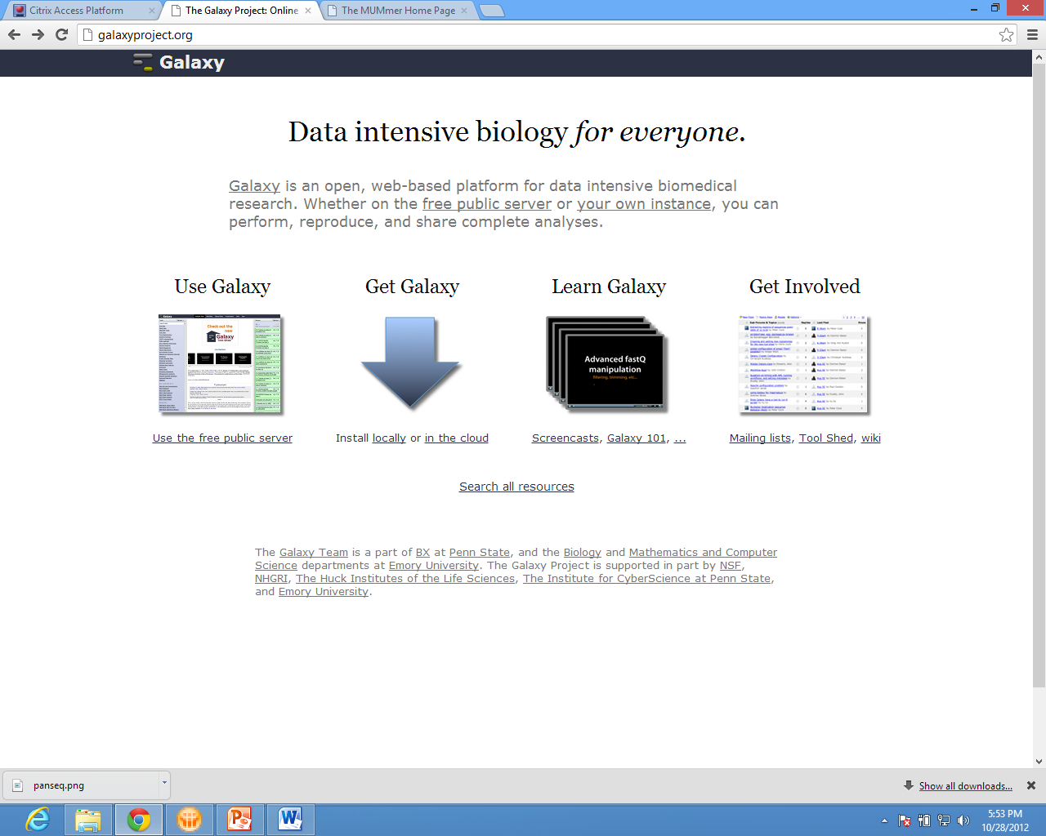
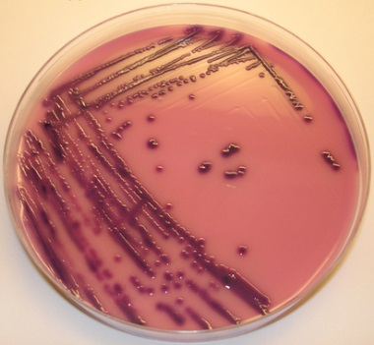
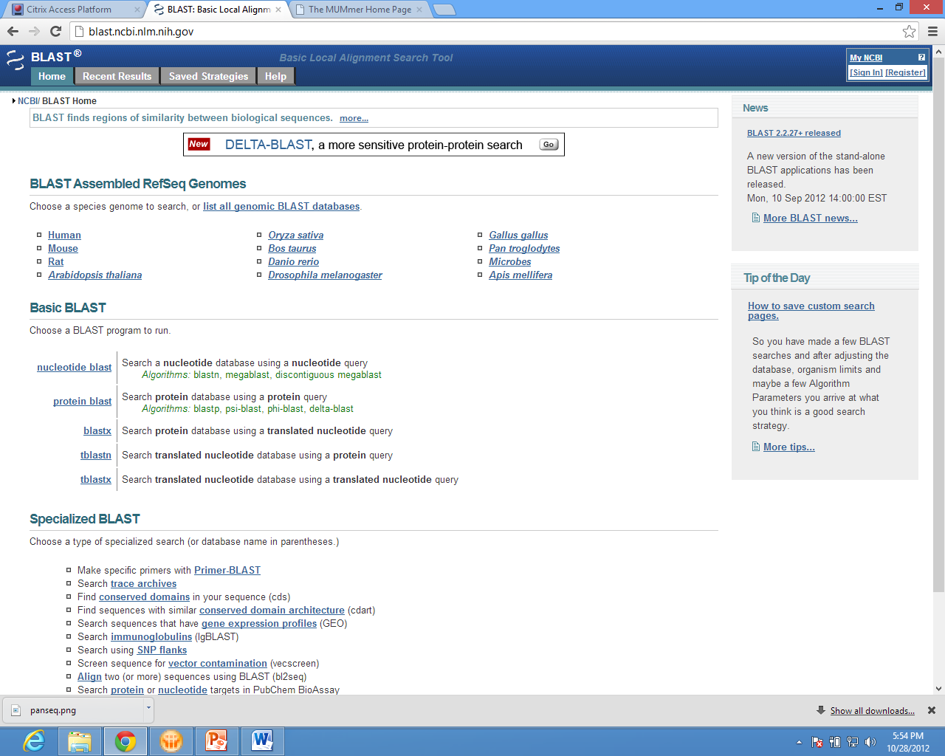
Download
Whole Genome
Sequencing

Slide 7
Programs designed for small number of sequences
Require local copies of data
Analyses duplicated between runs / people / groups

Slide 8
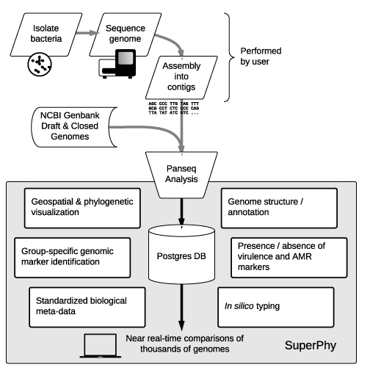

Slide 9

http://lfz.corefacility.ca/superphy

Slide 10
Presence / absence of pan-genome segments is calculated for each genome
Genome composition types:
Conserved: > 500 genomes Variable: < 500 genomes
SNPs identified in conserved segments
Panseq tool
Laing C et al (2010). BMC Bioinformatics.11:461

Slide 11
Panseq pan-genome pipeline:
Input genomes
Split into 1kb fragments
Identify non-redundant set using MUMmer
Map non-redundant set back to input genomes
Label conserved and variable fragments
Align fragments and identify SNPs

Slide 12
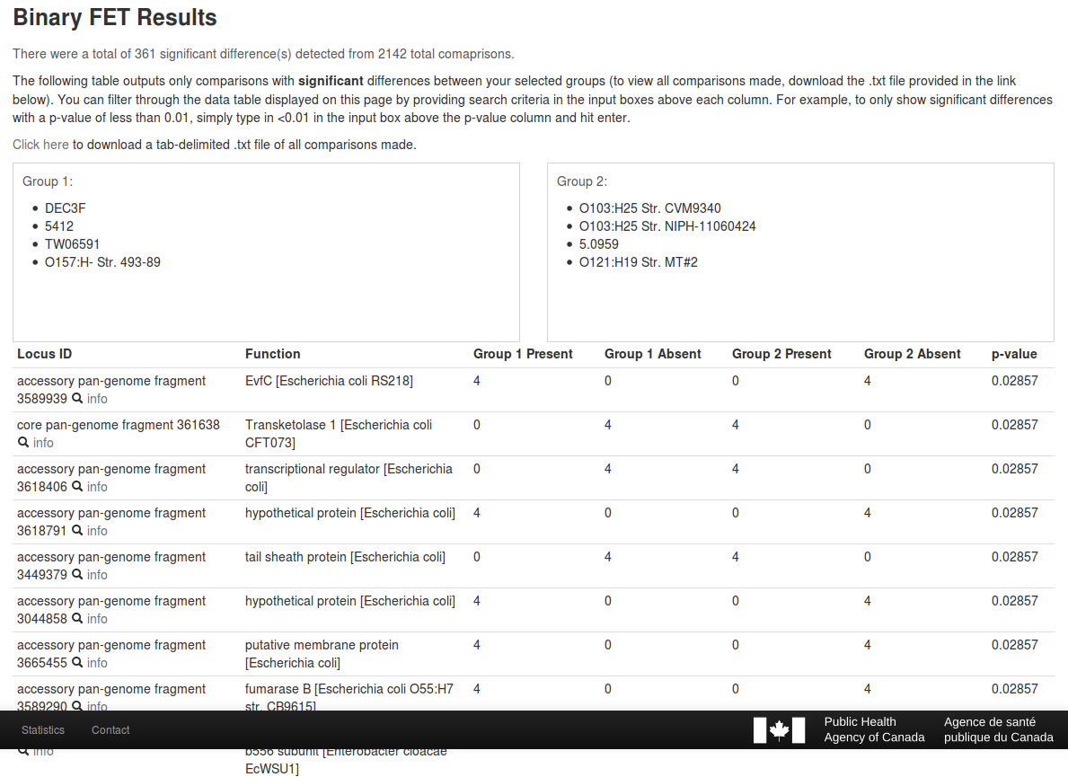
Presence / absence of genomic loci and SNPs can be compared across groups
Significance measured by Fishers Exact test

Slide 13
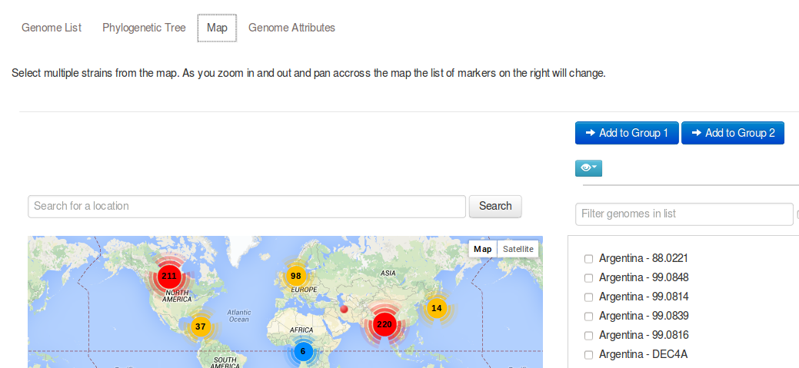
Groups can be selected from phylogenetic tree, by associated meta-data or by geographical location

Slide 14

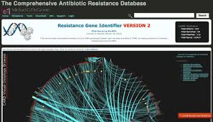
High quality set of VF and AMR used to search genomes
VFs from Virulence Factor Database
AMRs from Comprehensive Antibiotic Resistance Database
Augmented with our own curated genes
VF / AMR descriptions and categorical data from databases also loaded

Slide 15
High quality set of VF and AMR genes
Redundant VF / AMR gene alleles are eliminated
VF / AMR genes are grouped by sequence similarity using BLASTclust. Single representative is selected from highly similar groups
 | From external sources | Added by our curation team | Total after multiple alleles removed
AMR | 1598 | 0 | 611
VF | 319 | 159 | 307

Slide 16
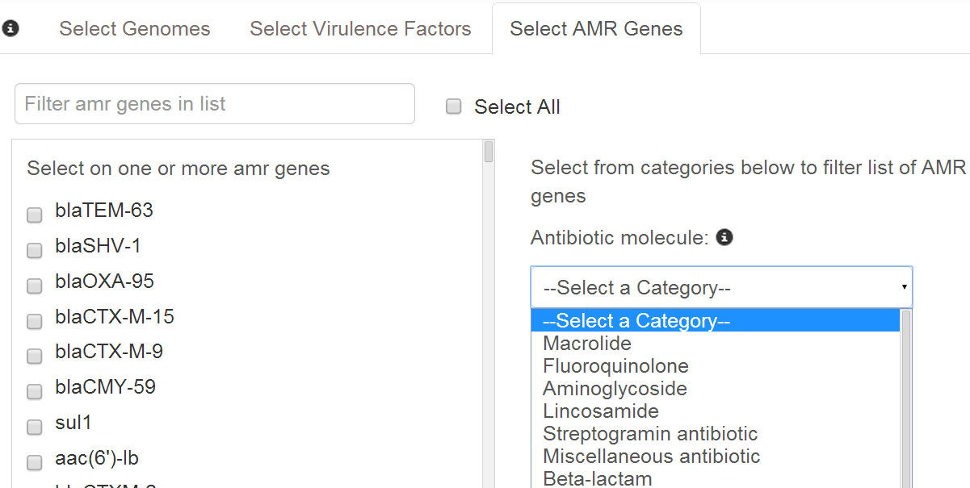
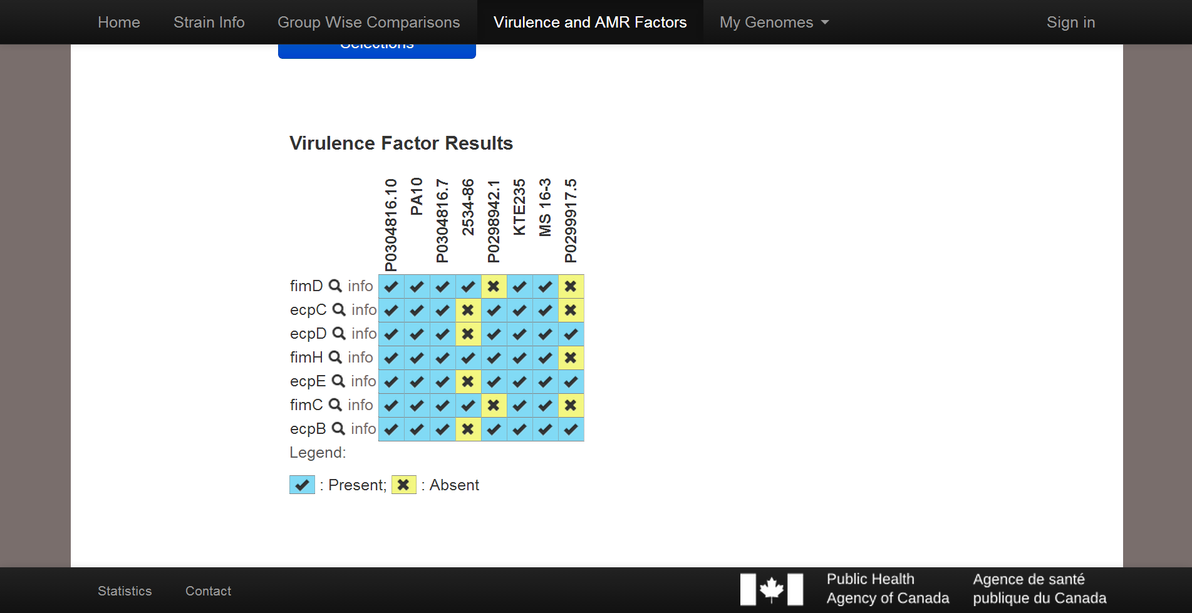
Clicking on info will open detailed view of VF / AMR

Slide 17
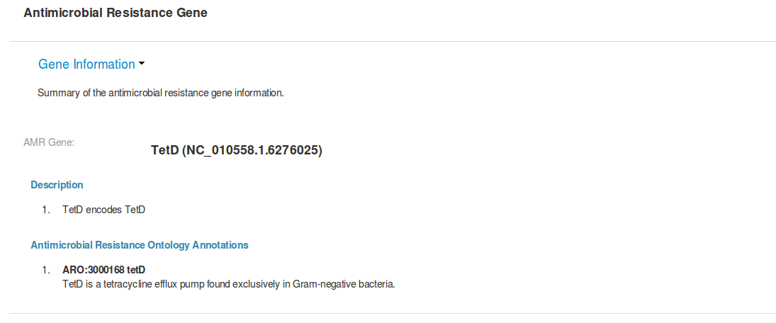
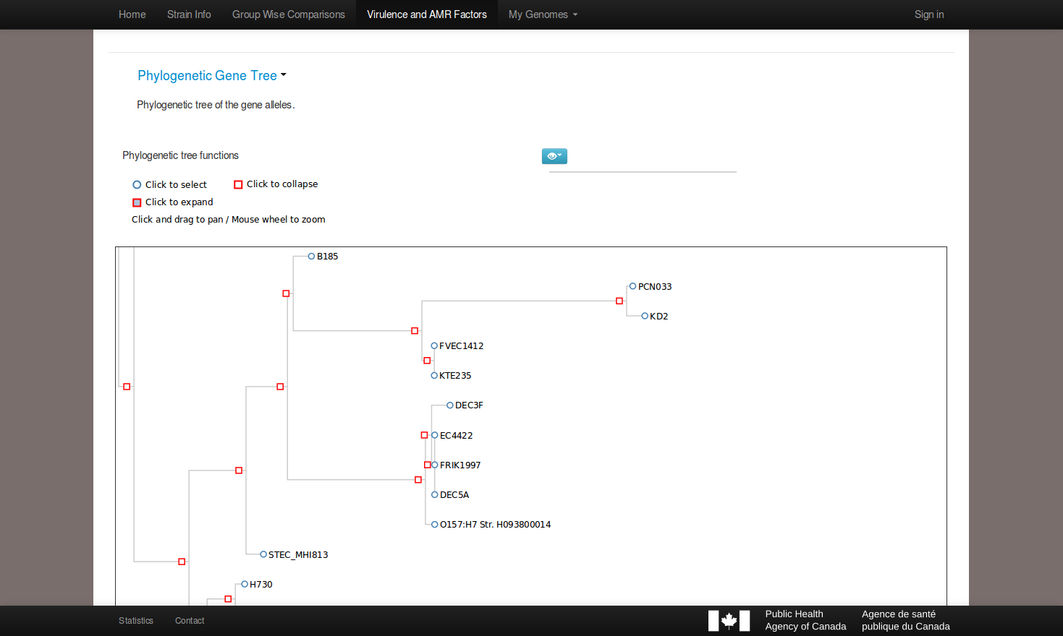
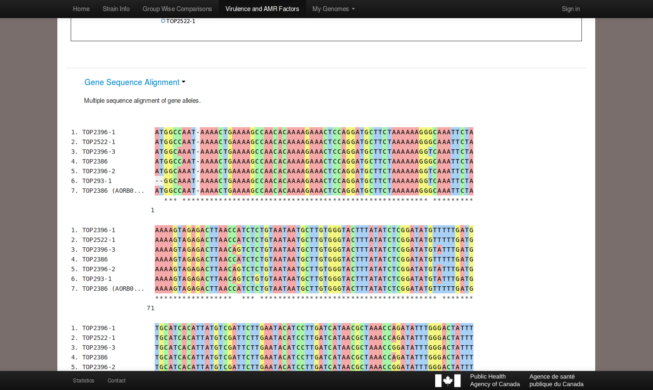
Detailed VF/ AMR view

Slide 18
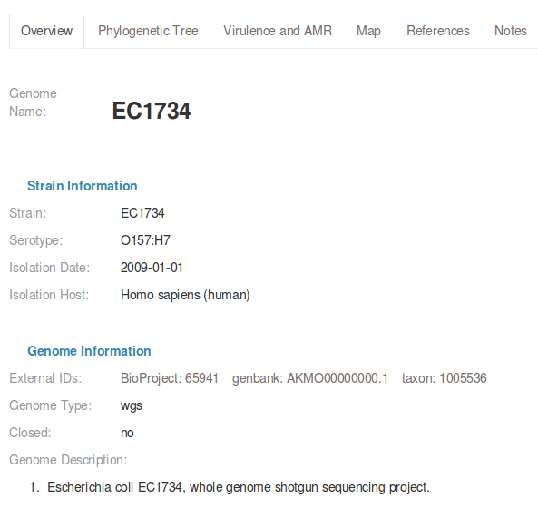
Genome info mapped to standardized meta-data types and values
Users provided lists / checkboxes when submitting genomes to improve consistency
Free-form still allowed

Slide 19
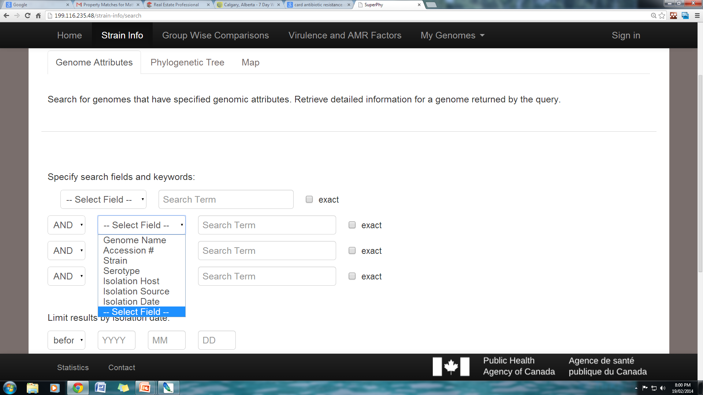
Strains queried by keyword or date boolean search, selection from phylogenetic tree or geospatial layout

Slide 20
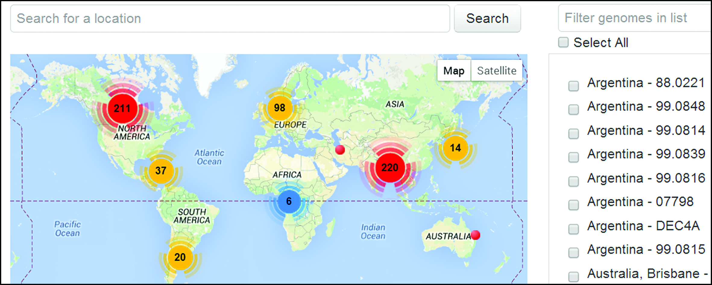
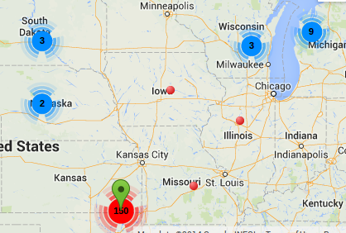
Geospatial view of strains

Slide 21
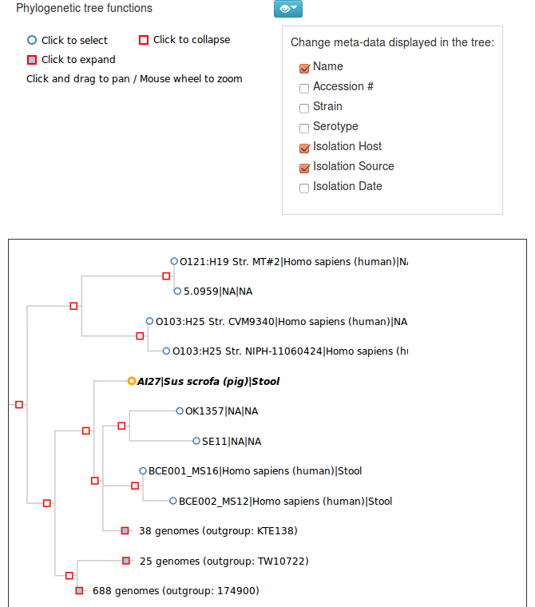
Strain phylogeny

Slide 22
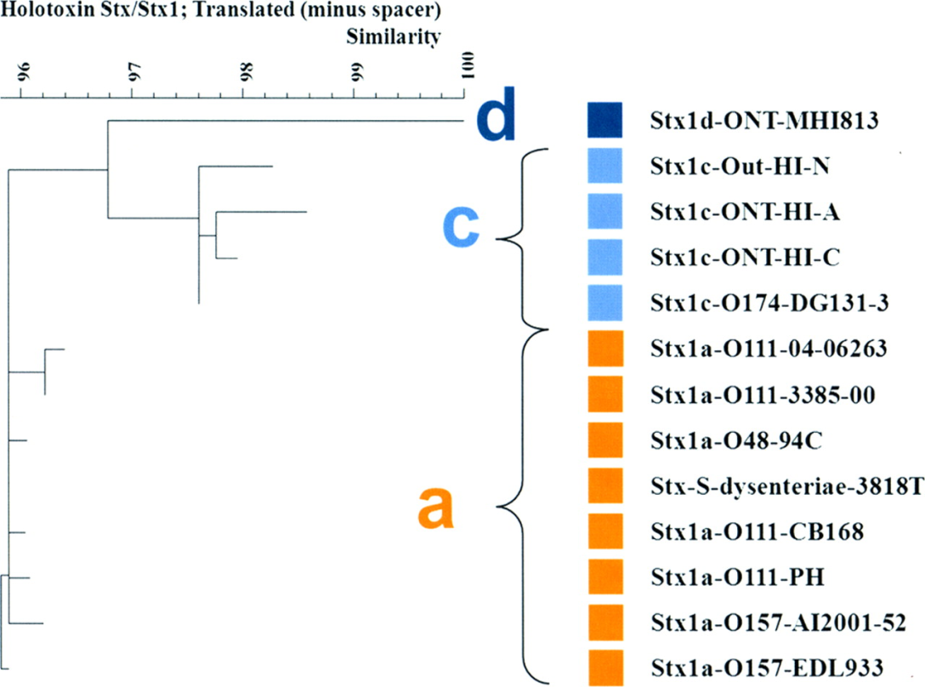
Epidemiological studies rely on typing methods to distinguish between bacterial strains
E. coli: serotype, shiga toxin (Stx) type, antimicrobial resistance pattern
Stx type determined using PCR assay
Stx1
Subtypes
Can we recapitulate ‘molecular’ subtypes using only sequence data?
J. Clin. Microbiol (2012) 50: 9. 2951-2963

Slide 23
Can we recover Stx subtypes using only sequence data?
BLAST vs Phylogenetic approach
Reference
Unknown
Unknown
Reference
Stx2d
d
Stx2c
Stx2c
c
c
Stx2c
?
?
Stx2d
d

Slide 24
BLAST vs Phylogenetic In silico Stx typing
In 5-fold cross-validation test, phylogenetic method more precise
Phylogenetic method, however, has lower recall. BLAST always makes a prediction.
Precision = TP/(TP+FP) Recall = TP/(TP+FN)

Slide 25
Future Screen Shot

Slide 26
SuperPhy: Pilot currently focused on E. coli analysis
DATABASE
Postgres 9.2 database
CHADO schema
WEB APPLICATION
Perl CGI::Application framework
Perl DBIx::Class framework
INTERACTIVE USER INTERFACE
JavaScript D3 Library
Google Map API

Slide 27

Whole Genome Shotgun Sequences
Closed Genomes
1063 Genomes
SuperPhy DB
User-Submitted Genomes

Slide 28
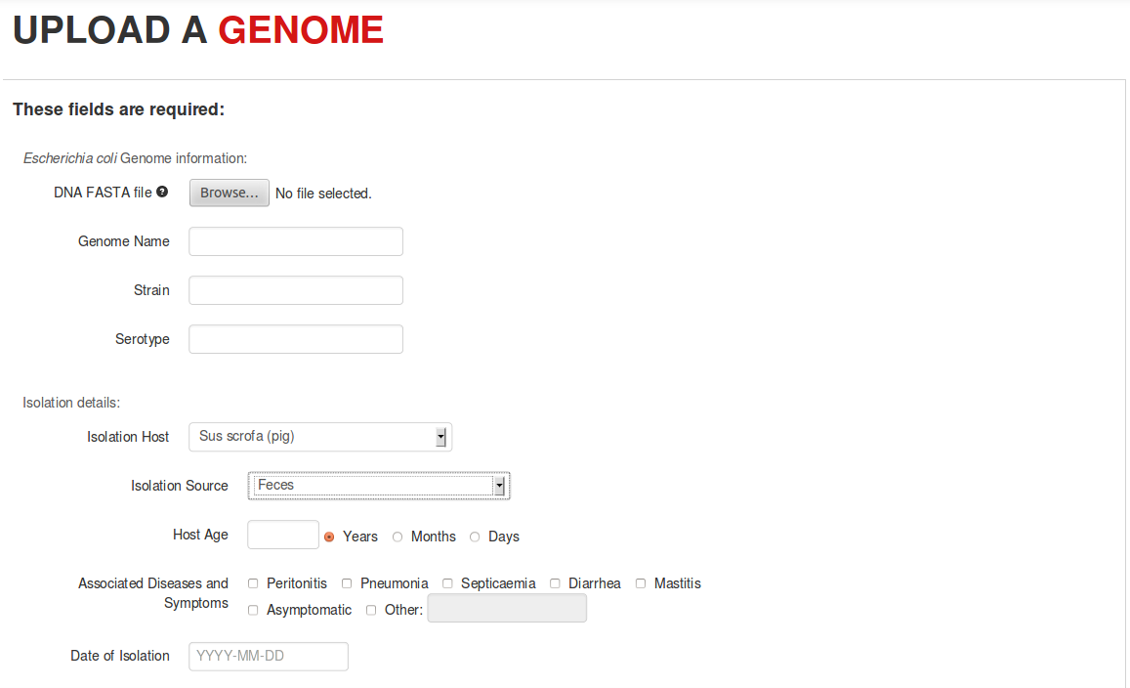
Users can upload their own E. coli genome sequences for analysis

Slide 29
Users can upload own E. coli genomes for analysis
User data can be set as:
Can also release data to public after specified date
Private
User controls who can view or modify their data
Public
Everyone can view
Specified users can modify

Slide 30
Clinical microbiologist wants to determine risk level & whether part of larger outbreak for patient isolate
Isolate strain
Sequence & assemble to draft stage
Upload to SuperPhy
Risk Assessment
Outbreak Analysis
Similarity to other virulent strains
VF and AMR profile
View phylogenetically-related strains in tree
Observe geographically close strains in map

Slide 31
http://lfz.corefacility.ca/superphy
SuperPhy integrates user- and public genomic data with computational analysis tools
Intuitive online interface
Powerful visualizations and search queries
Results available in near-real time and can be shared
SuperPhy bridges genome data to real-time, expert-guided surveillance / analysis network

Slide 32
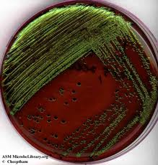
AMR Disk Diffusion
PCR of virulence genes
MLST
$561 materials
168h
(48h; $190)
(72h;
$5k machine,
$356 / sample)
(48h;
$15 / genome)
=
Wet Lab
SuperPhy
Genomic DNA Isolation
MiSeq
(8.5h;
$120k machine,
$130 / genome)
$133 materials
35.5 h
=
(24h; $3)
(3h)
Notes:
Based on:
$3.08/sample gDNA isolation using Invitrogen PureLink DNA 250 sample kit
$131/sample MiSeq (assuming batch of 24 per run, latest Genome Quebec price)

Slide 33
Contributors:
Omar Zabaneh, Peter Shen, Michael Benediktson, Waqar Gill
Funding:
Public Health Agency of Canada
Genomics Research and Development Initiative

